Slide 1

Green Pace
Security Policy Presentation
Developer: Eric Wallace

Slide 2

OVERVIEW: DEFENSE IN DEPTH
The security policy introduced is one that relies on the following of industry standards and guidelines to create a multi-layered approach to secure coding. With all the security threats made possible by the highly technological world of today, a sound security policy such as the one below is a must.

Slide 3
THREATS MATRIX
Secure coding standards contains risk assessments metrics outlining possible consequences that developers can use to prioritize vulnerabilities and bugs in code.
Likely High probability if violated can lead to an exploitation | Priority Highest severity & Indicates serious problems
Low priority Lowest severity, unlikely to happen & highest repair cost | Unlikely Flaw with low probability of exploitation

Slide 4
10 PRINCIPLES
Validate Input Data
Heed Compiler Warnings
Architect & Design for Security Policies
Keep It Simple
Default Deny
Adhere to the Principle of Least Privilege
Sanitize Data Sent to Other Systems
Practice Defense in Depth
Use Effective Quality Assurance Techniques
Adopt a Secure Coding Standard

Slide 5
CODING STANDARDS
Exclude user input from format
Do not access freed memory
Detect and handle standard library errors
Guarantee that storage for strings has sufficient space for character data and the null terminator
Range check element access
Use only explicitly signed or unsigned char type for numeric values
Handle all exceptions thrown before main() begins executing
Do not attempt to modify string literals
Converting a pointer to integer or integer to pointer
Use a static assertion to test the value of a constant expression
The method I used to rank the 10 standards was to first rank them by severity with the highest being first and then within the same severity, order them by the likelihood the standard will lead to a flaw if violated or ignored.

Slide 6
ENCRYPTION POLICIES
The three policies listed below are the three primary states of data, each have their own set of risks, characteristics of data and steps to prevent data from being compromised. One feature they all share is that data is scrambled into cyphertext.
Encryption at Rest – Data at rest refers to the encrypting of stored data to prevent unauthorized access. The data can only be decrypted with the use of a key, while this is usually the data most valuable to a hacker, it is useless without the key.
Encryption in Flight – Data in flight refers to the encrypting of data that is actively moving between two network locations. This data is more vulnerable than data at rest as it is susceptible to eavesdropping, leakage and ransomware attacks.
Encryption in Use – Data in use refers to the encrypting of data as it is being used, it is a relatively new approach to data security but eliminates a lot of vulnerabilities not covered by traditional encryption.

Slide 7
TRIPLE-A POLICIES
Authentication, authorization and accounting are part of the User Identity and Access Management solution in Defense in Depth.
Authentication – Is the identification of users through requesting private information such as username and password which ensures they are whom they claim to be.
Authorization – Is the method of determining if a user should be permitted to access data and how a user may interact with that data
Accounting – Is the process of keeping track of what a user is doing with the access they have. It logs session statistics and usage information.

Slide 8
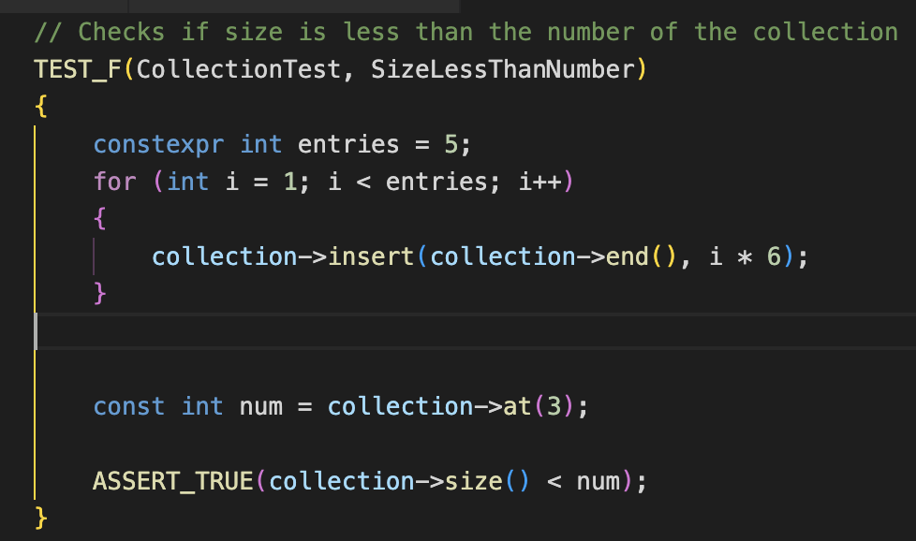
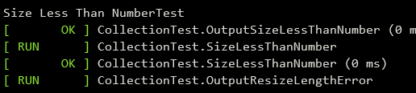
Unit Test: Size Less Than Number
This test shows the use of for loops to insert data into a collection and then how that data can be used in the test. This is useful if there was a need for testing to make sure all data within a list or hashtable was of a certain data type.
Unit Test Test Result

Slide 9
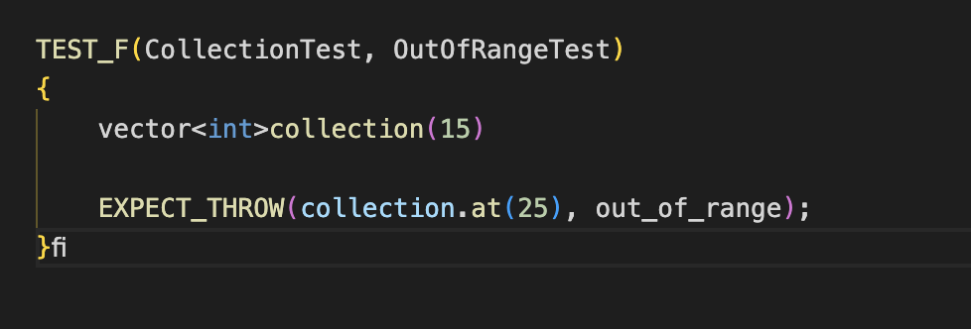
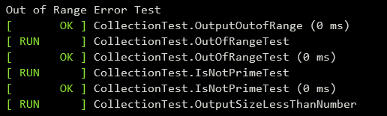
Unit Test: Out of Range
This test expects out_of_range error to be thrown when an index that is outside the bounds of the collection.
Unit Test Test Result

Slide 10
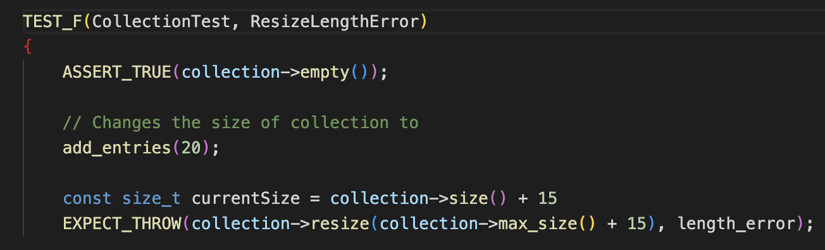
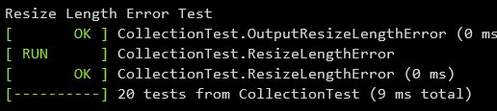
Unit Test: Resize Length Error
This test expects a length_error to be thrown when a collection resized larger than its max size
Unit Test Test Result

Slide 11
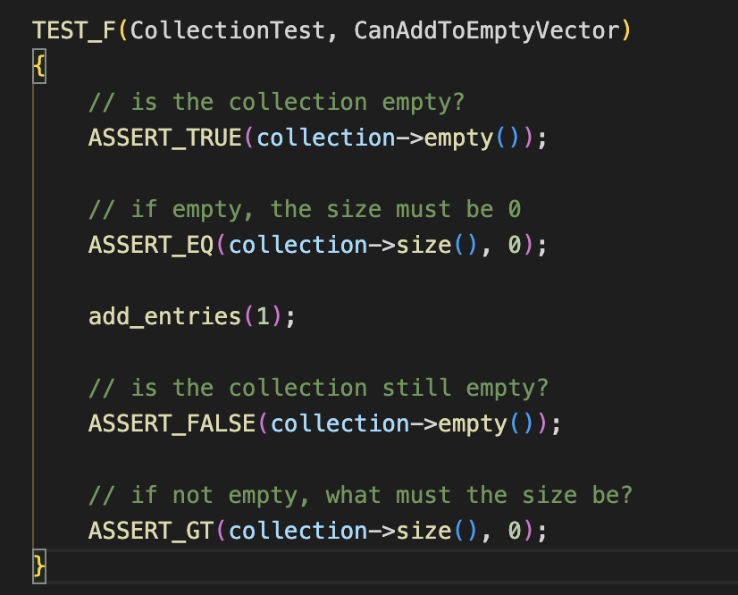

Unit Test: Can Add To Empty Vector
This test ensures values can be added to an empty collection
Unit Test Test Result

Slide 12

AUTOMATION SUMMARY

Slide 13
TOOLS
Green Pace will modify their current DevOps process in the “Verify and test” and “Design” stages. The implementation of new static analysis tools to scan code for vulnerabilities, test code, detect dead code, and errors in code according to standards and guidelines. The code will need to be modified to ensure the code follows current standards and code. Each time code is modified, static code analysis will need to be performed to determine if the newly developed code introduces any additional vulnerabilities or error in code. Additionally, penetration testing can be carried out during transition and health check stages to make sure the code does not allow unauthorized access to it via the internet.

Slide 14
RISKS AND BENEFITS
The risks of deciding to wait before implementing security policies is greater the chance of an attack. This can result in a loss of time, damages to equipment, increased cost, and company reputation. The implications for developing code with known security risks can be catastrophic to a company if the software is released for purchase.
If security is implemented during development, it can prove beneficial. Not to mention it will reduce code rewrites and development to delivery times will decrease. It also results in software that is much more secure than if a developer waits until the end to implement security.

Slide 15
RECOMMENDATIONS
One common gap in security is the failure to install updates on outdated software
Developing a mechanism for software developed by Green Pace to receive updates patching future vulnerabilities and exploits can improve the software as well as reduce the gap in security.
Educating developers in the latest security standards and techniques to develop secure code could reduce security gaps.
Update security policies that accounts for current most widely known techniques used by hackers to defeat security.
An example of how updating software released by the developer can reduce security gaps. Back in 2007 I worked for a law firm, and they had some custom software that was used for billing, entering time, and entering notes regarding the case including court dates and such. We had a production environment and a test environment. There was a Java bug found that left software vulnerable to data breaches, the production environment was patched but not the test environment. Three weeks after the patch was released the test environment was attacked using the exploit found in Java. Luckily, there was no actual intelligible data to be obtained from the attack, but this goes to show how updating software can prevent attacks.

Slide 16
CONCLUSIONS
In conclusion, it is vital to have a plan for when attacks or breaches are successful. Having security policies and contingencies are paramount in today’s world. While it is impossible to account for every scenario and be 100% protected, following standards and guidelines, and using analysis tools will provide the most protection.
If developing software for customers, it is very important to issue updates to finished products to prevent attacks to customers and secure their data. The last thing Green Pace wants is to have their reputation tarnished because software they developed was tied to a data breach or leakage.

Slide 17
REFERENCES
Greycastle Security.How to conduct a cybersecurity gap analysis for your tech business. greycastlesecurity.com. Retrieved Apr. 9, 2023, from https://greycastlesecurity.com/cybersecurity-blog/how-to-conduct-a-cybersecurity-gap-analysis-for-your-tech-business/
Purandar Das.In-use encryption – what it is and how companies benefit. soterosoft.com. Retrieved Apr. 9, 2023, from https://www.soterosoft.com/blog/data-in-use-encryption-data-in-motion-encryption/
Sibanda, I. (2022). Data in transit encryption explained . phoenixnap.com. Retrieved Apr. 9, 2023, from https://phoenixnap.com/blog/data-in-transit-encryption
VELIMIROVIC, A. (2021). Data encryption at rest explained . phoenixnap.com. Retrieved Apr. 9, 2023, from https://phoenixnap.com/blog/encryption-at-rest

